Slide 1




Loyalty Experience Platform
Presentation
Kenn Kennedy - Account Executive

Slide 2


Annex Cloud Overview
Our Customers
Core Platform Features & Value Add
Integrations
Working with Annex Cloud
Key Modules: Highlight
Contents

Slide 3











200+
15+ Billion
225
Global Enterprise
Customers
Application clicks a month
Employees
HQ in Allen, TX USA
Founded in 2010
Privately Held
Global hubs in
Germany and India

Slide 4
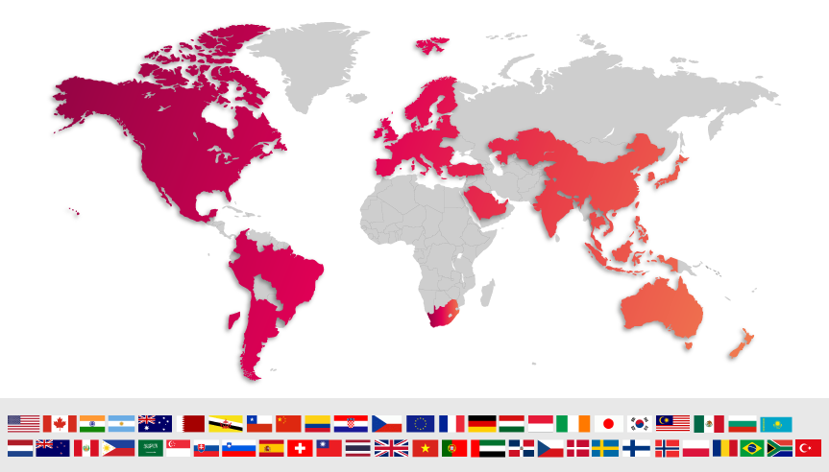
Global Presence and Expertise

Slide 5























Hundreds of Global Programs with 100M+ members
Enterprise (>$1B)
Mid-Market

Slide 6
















Loyalty Experience Manager
Communications
Experience Manager
Program Types
Multi-Template
Rewards
Rewards
Tech Stack
Marketing
Channels
Social & Behavioral
Transactional
Tiered
Points & Badges
Coupons, Vouchers & Rebates
Merchandise
CRM
Premium/Paid
Memberships
Receipt/Invoice Scanning
Coalition/Partner
Charity Rewards
Branded & Virtual Gift Cards
3rd Party Gift Cards/Rewards
Web
Engagement Experience Manager
CX
Refer a Friend
UGC / Visual Commerce
Influencer Management
Ratings & Reviews
Questions & Answers
Gamification & Contests
ERP
SMS
Customer Experience Manager
ESP
Registration
as a Service
Loyalty Experience Microsite
Rewards Store
Print
Loyalty Experience Platform™
POS
Social Media
Loyalty Engine
eCommerce
Data Management
Loyalty Member Profile
Segmentation
Member Data Management
CDP
Email
Loyalty Rules Engine
Campaign Management
Personalization
Mobile/PWA
Intelligence
Predictive Intelligence
Reporting & Analytics
App
Payment
Providers
Open APIs
Global Enterprise Ready
Mobile APIs
Foundation
Web SDK
Extensibility/Apps
Pre-Built Integrations
Confidential 1.14.22

Slide 7


Forrester Categories | Annex Cloud | Average of Other Loyalty Providers in Report
Loyalty Management | 5 | 3.1
User Experience | 5 | 3.3
Execution & Innovation Roadmap | 5 | 2.8
Integration and Partnerships | 5 | 3.3
Annex Cloud received highest scores possible in 15 criteria in the Forrester Wave™:
Loyalty Solutions, Q2 2021 Report.
All areas that matter most to
loyalty marketers.
Loyalty Management
User Experience
Execution
Innovation roadmap
Integration and partnership
  “fast and frictionless that is modular, extensible, and scalable”
“tech centric vision supported by separate roadmaps”
“Annex Cloud is a great partner, calling out its listening skills and advocacy”
“We feel like it has our best interest in mind as we work together”
Confidential
Notes:
Annex Cloud ranked highest in 15 categories in the Forrester Wave and was also the most improved vendor from two-years prior.

Slide 8












Snapshot of Ecosystems and Integrations
Platforms (multiple integrations)
Marketing + Commerce Technologies
Commerce Cloud (formerly Demandware), Marketing Cloud (formerly ExactTarget), Sales Cloud/CRM, Service Cloud, Mulesoft
Adobe Experience Manager (AEM), Commerce (formerly Magento), Adobe Campaign, Marketo
Commerce (formerly Hybris), SAP Marketing Cloud, Customer Data Cloud (formerly Gigya). CAR/PMR/OPP, ERP
ERP, Commerce (SCA), POS (SCIS)
125+ others

Slide 9
Working with Annex Cloud
Technical Architect
Product Manager
Assigned
Implementation
Manager/PM
Loyalty Strategist
Customer Success Leadership
Creative/Design
Marketing Specialist
Data/Analytics
Customer Success Manager & Onboarding Lead
Customer
Team
Assigned Integrations
Manager
Director of Integrations

Slide 10
Implementation Process
Deploy
5
Discovery
1
Define
2
Design
3
Develop & Deliver
4
Week 1
Week 2
Phase 1 - Discovery
Goal alignment, competitive, business download, business and technical requirements, deadline/technology/other constraints, agree on next steps and timeline
Week 3
Phase 4 – Develop & Deliver
Configure system for program structure, offers, rewards, segments, analytics, offers / engagement, & integrations
Week 4
Week 5
Phase 2 - Define
Program structure, customer segments,
journey/engagement points, KPIs
Week 6
Week 7
Week 8
Phase 3 - Design
Define UX, design development: dashboard, social, email, offline
Week 9
Phase 5 - Deploy
Push code to staging, QA/UAT testing, fixes, migration of data, training
Week 10
Week 11
Week 12
Week 13
Base implementation is approximately 13 weeks

Slide 11
Ongoing Partnership Alignment: Continuous Evolution of Loyalty
Annual Strategy Workshops
Annually:
Strategy and roadmap workshop
NPS/satisfaction surveys (ongoing)
Quarterly:
Review past quarter performance, provide recommendations, discuss loyalty trends, product enhancement, set KPIs
Executive check-in throughout
Strategic Planning
Quarterly Business Reviews
Weekly/Monthly Reporting, Tracking & Review
Status Meetings:
Reporting, post-campaign review, initiative tracking
Day-to-Day:
Blocking and Tackling
Ongoing Day-to-Day Contact

Slide 12

Improved Trust and Customer Experience especially in the uncertain times
Higher Margins when retaining existing customers
Repeat purchase rates, AOV, LTV
Keeping customers engaged in between purchases
Incentivizing customers to take action without discounting
e.g. Buy on a new channel, Visit our store
Rewarding advocacy
e.g. Referring other customers, or writing a rating or review, sharing social content (images, videos)
Solving Problems
for the Business

Slide 13
True focus on Customer Centricity: Customer experience at the core with emotional loyalty
Industry’s Widest Platform: Breadth of product, highly configurable, customizable and extensible
Built for Enterprise: Scalability, Global Availability, Security, Compliance, enterprise ready features
Most Ecosystem Integrations: Key integrations with Salesforce, SAP, Adobe, Oracle, Netsuite, Episerver, Shopify and others - across Commerce, Marketing, ERP, CRM, POS, CDP and more.
Key Differentiators

Slide 14
Customizable Loyalty Rules Engine (Actions, Behaviors, Points, Tiers, etc.)
Extensible Rewards & Promo Engine
Segmentation, Targeting, RFM
Configurable global capabilities (language, currency, timezone, interoperability)
Extensive Pre-integrated systems (ERP, Commerce, Marketing Cloud, POS, CDP) + APIs, SDKs to extend
Extensible KPI analytics (LTV, RPR, AOV)
Scalability, Global Availability (AWS+Azure across 6 global regions) and 24/7/365 Global support
Core Platform
Features

Slide 15
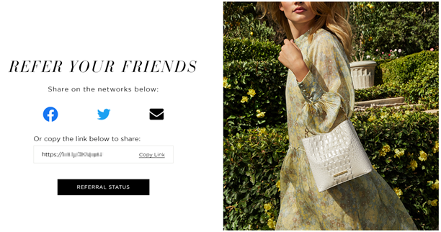
Refer A Friend
Reward customers for
referrals to create brand ambassadors – omni-channel

Slide 16
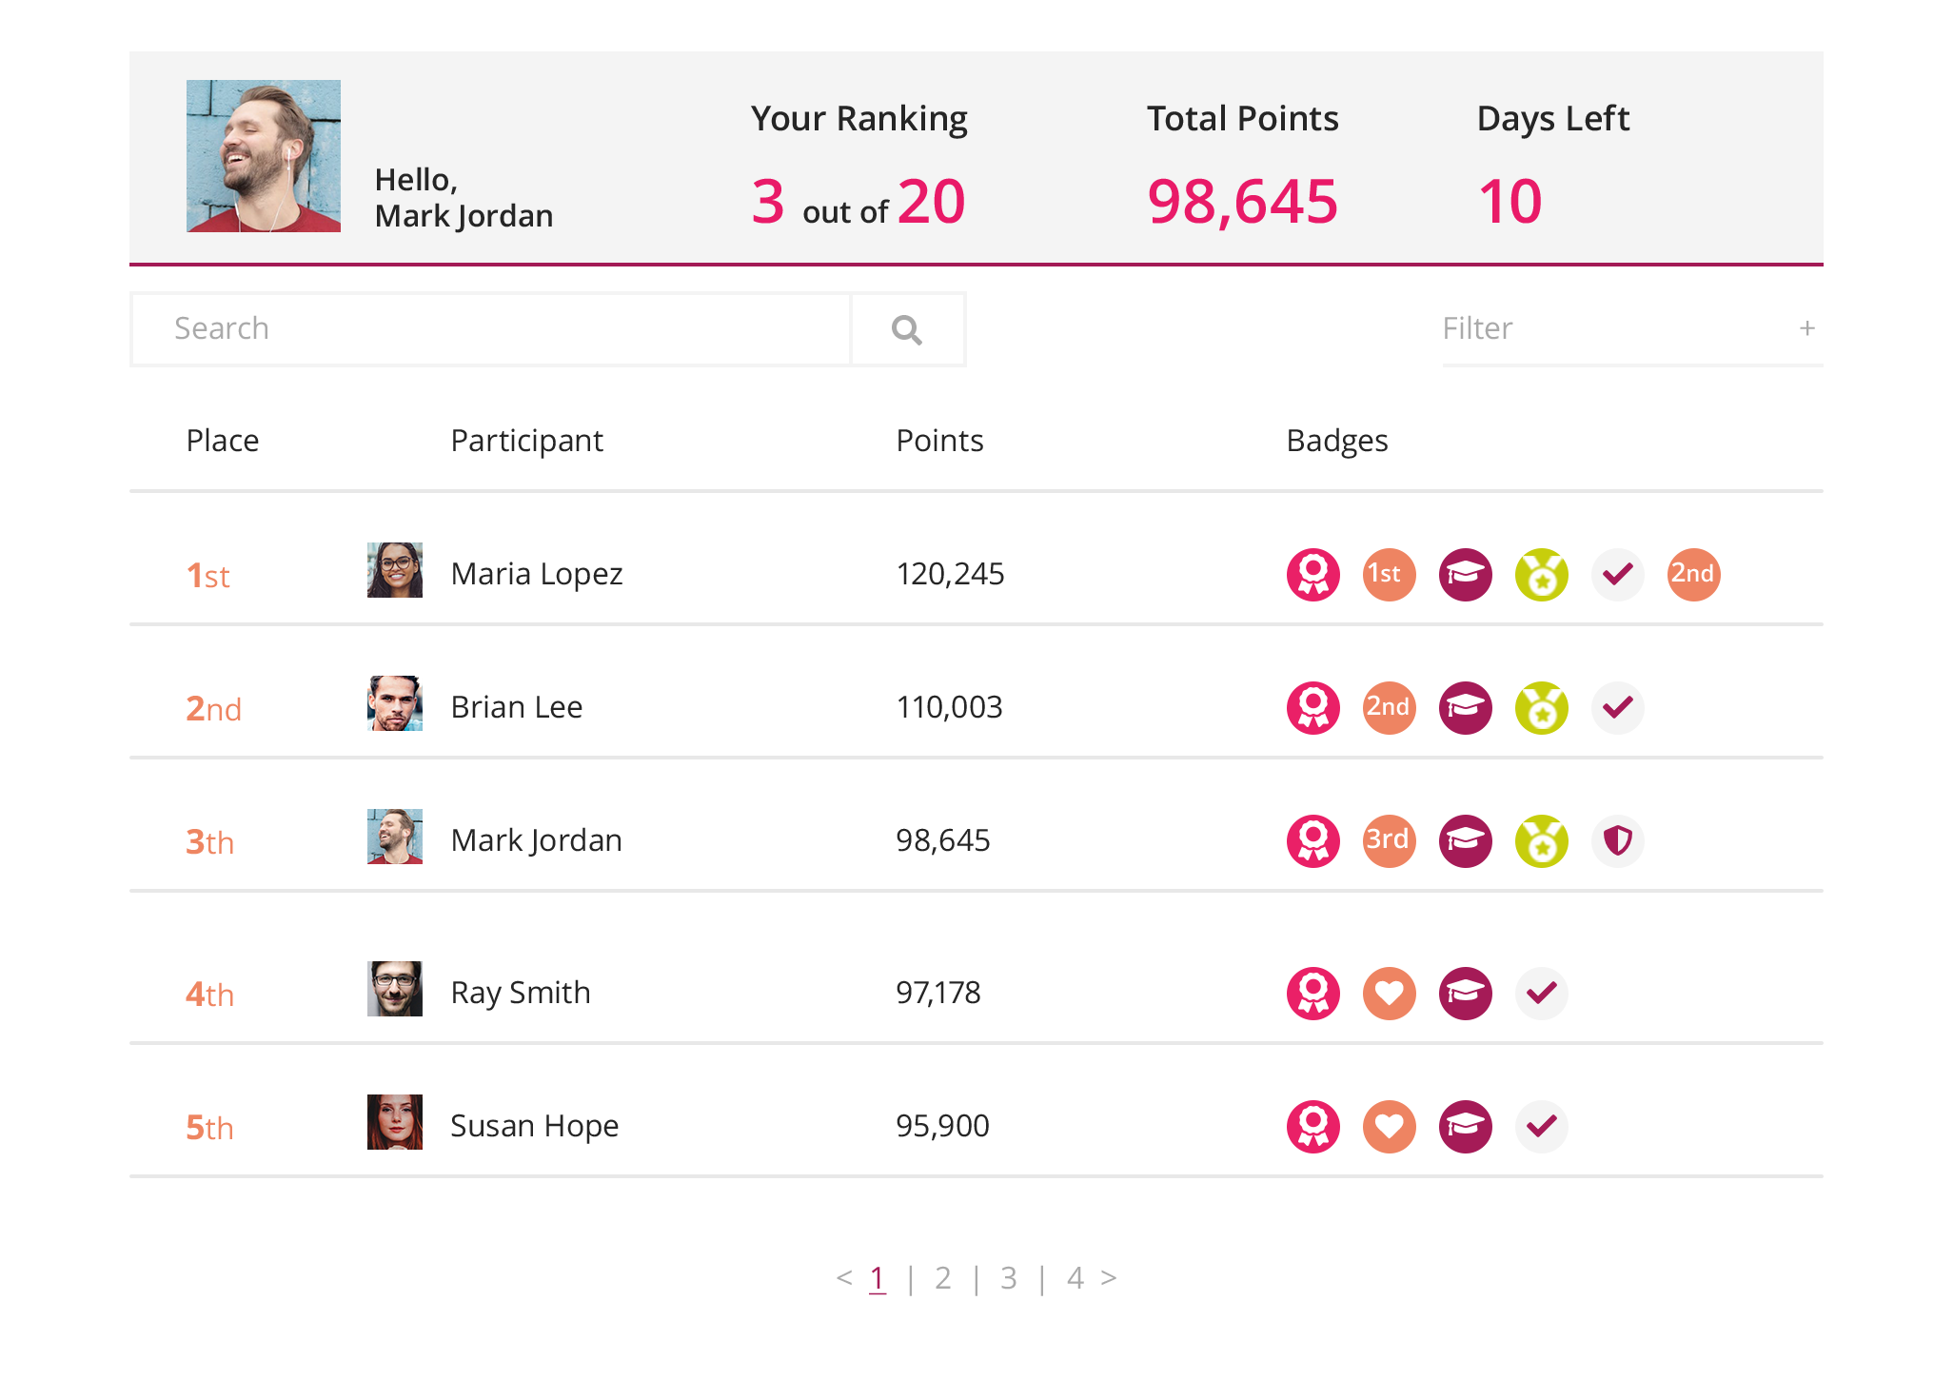
Gamification & Leaderboard
Use badges and achievements to increase customer participation

Slide 17
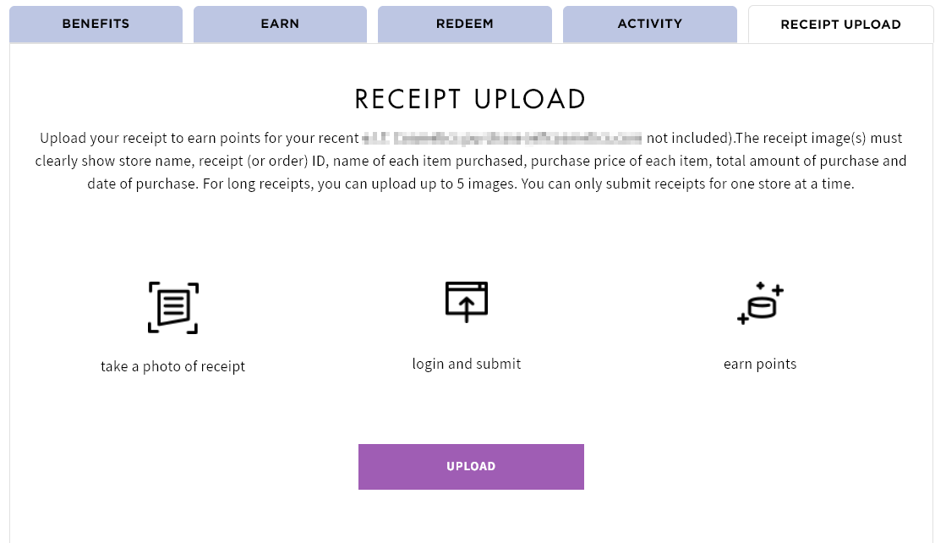
Native Receipt Scanner
Reward customers for purchasing your products no matter where they buy them

Slide 18

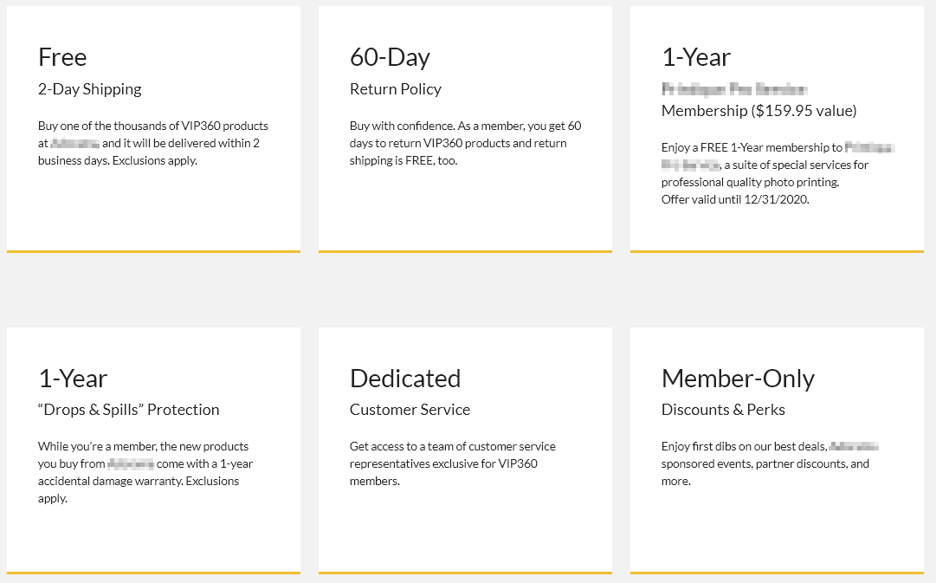
Paid
Membership
Increase revenue and participation for offering exclusive VIP benefits

Slide 19
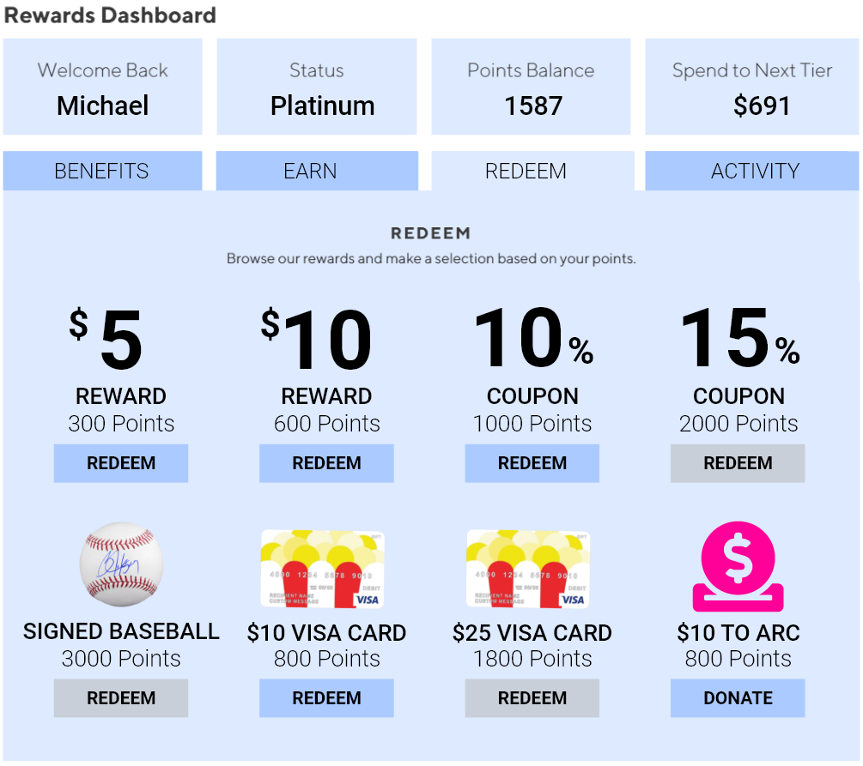
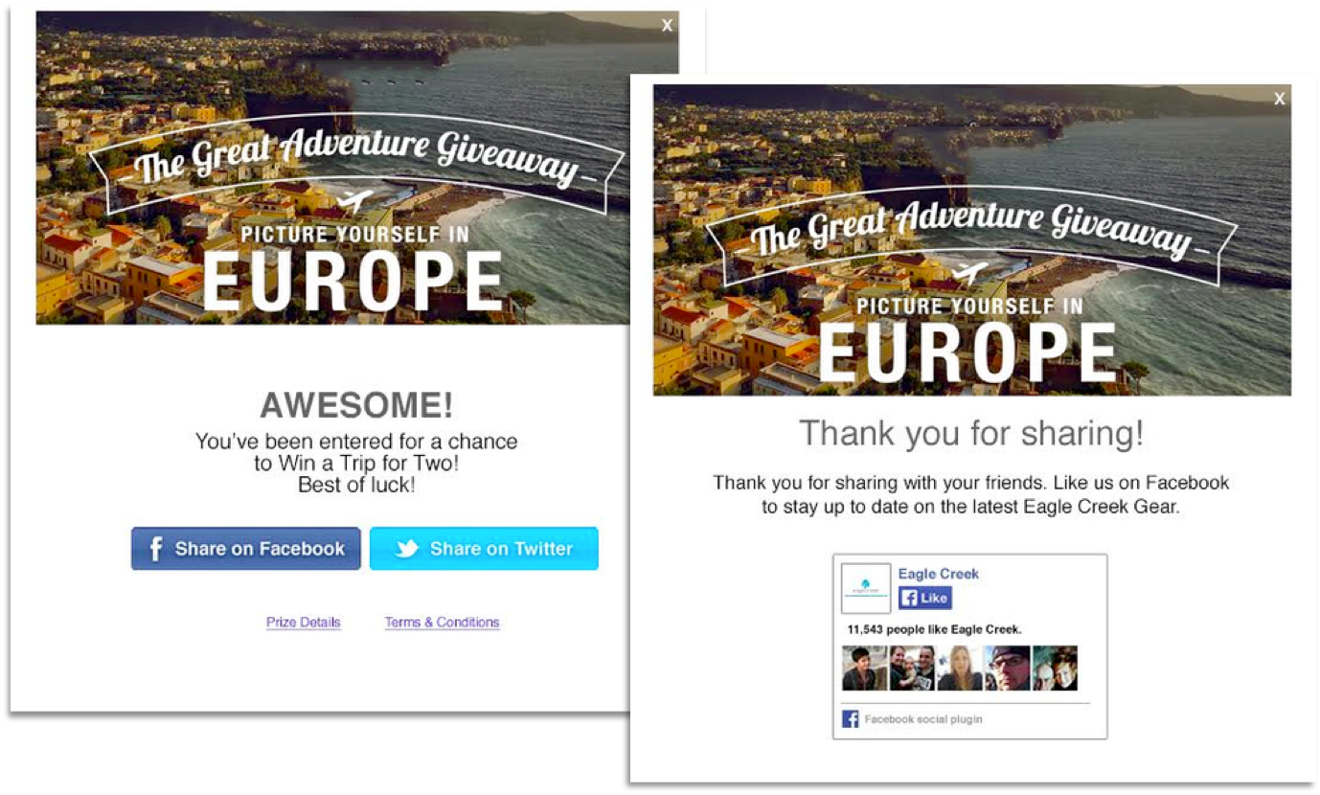
Types of Reward Redemptions
Annex Cloud enables your member to redeem their loyalty rewards using a variety of redemption mechanisms including:
Product Redemption
Coupon Code Redemption
Checkout Redemption
Credit Redemption
Charitable Donation
Third Party Merchandise
Custom & Third Party Gift Cards
Experiences

Slide 20
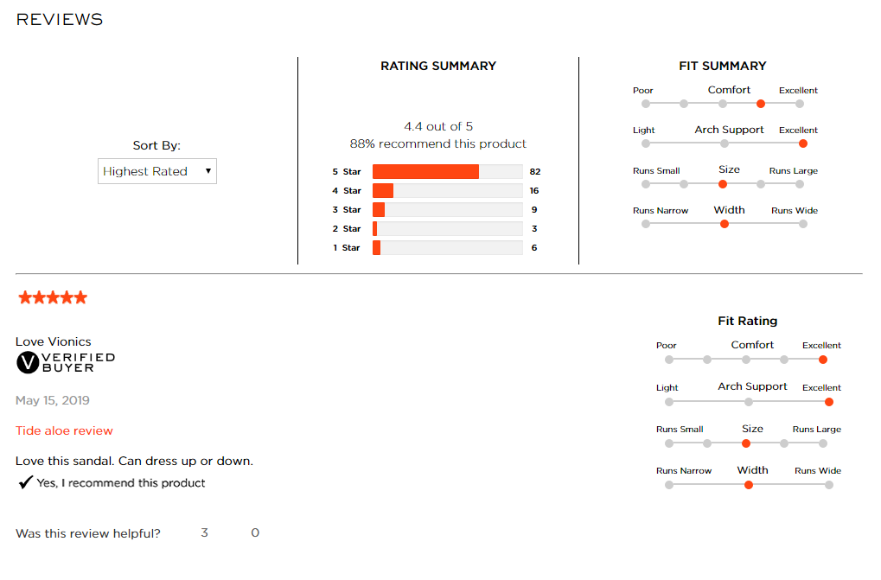

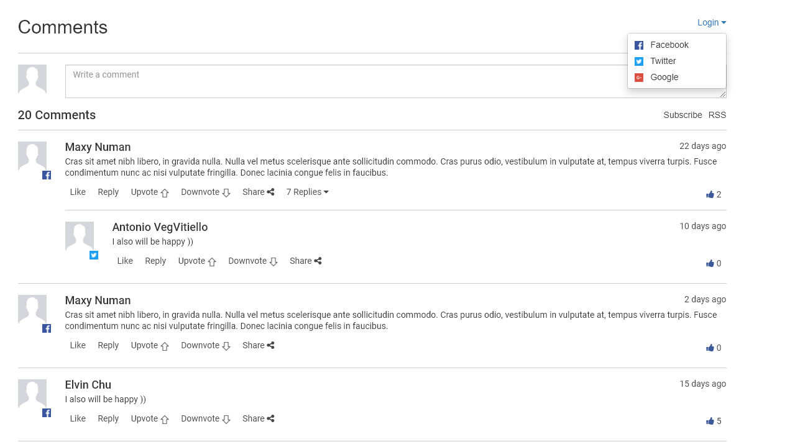
User Generated Content
Ratings & Reviews
Social Q&A
Visual Commerce

Slide 21



Incentive &
Promotion
Engine
Design and configure incentive-based rewards like coupons, vouchers, and gift cards to increase consumer participation

Slide 22



THANK YOU

